Slide 1
Developing an Online Voting System in Java
Project DONE BY
NIVETHAKUAMRI RAJNIKANDH

Slide 2
Abstract:
Introduction to the development of an online voting system using Java.
Overview of the features and functionalities implemented in the system.
Importance of secure and efficient online voting systems in modern democracies.
Objective:
To create a user-friendly online platform for voting.
To ensure eligibility verification and prevent duplicate voting.
To provide real-time updates on candidate votes.
To utilize various Java technologies for implementation.
Application Overview:
Name: Online Voting System
Functionality: Allows users to vote for candidates online.
Key Features:
Eligibility verification based on age.
Real-time vote counting.
User-friendly interface with GUI elements.
Utilization of Java's threading for responsive UI.
Implementation of interfaces for event handling.
Organized code structure using packages.

Slide 3
Technology Used in Java:
GUI (Graphical User Interface):
Utilized Swing library for creating interactive GUI elements.
Implemented JLabels, JTextFields, JComboBoxes, JRadioButtons, and JButtons for user input and interaction.
Designed a visually appealing interface for the voting system.
Threads:
Implemented threading for responsive user interface and background tasks.
Utilized SwingUtilities.invokeLater() for safe GUI updates.
Ensured smooth execution of tasks without freezing the UI.
Interfaces:
Implemented ActionListener interface for handling button clicks and user actions.
Utilized KeyListener interface for input validation.
Ensured proper event handling and user interaction.
Packages:
Organized code into packages for better modularity and maintainability.
Segregated UI components, event handling, and business logic into separate packages.
Enhanced code readability and scalability.

Slide 4
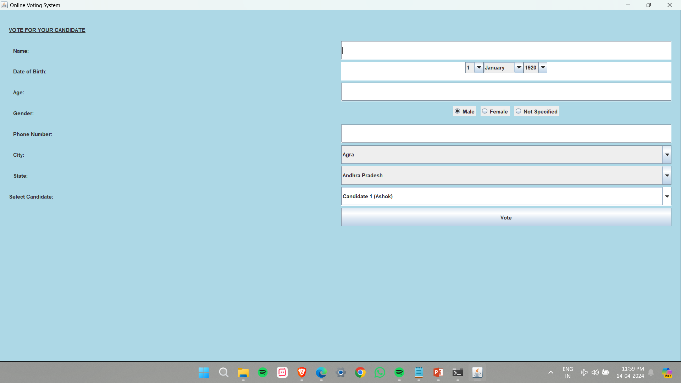
SAMPLE SCREENSHOT OF THE PROJECT
Online Voting Site which consists of Name field, Date of Birth field, Age field, Gender field, Phone Number field, City and State field, and Candidate field.
A Title is given as “Online Voting System” and a heading is mentioned as “VOTE FOR YOUR CANDIDATE”.
The Close, Maximize, and Minimize icons are present in Java AWT by default.
The Background of the Frame is set as “Light Blue”.

Slide 5
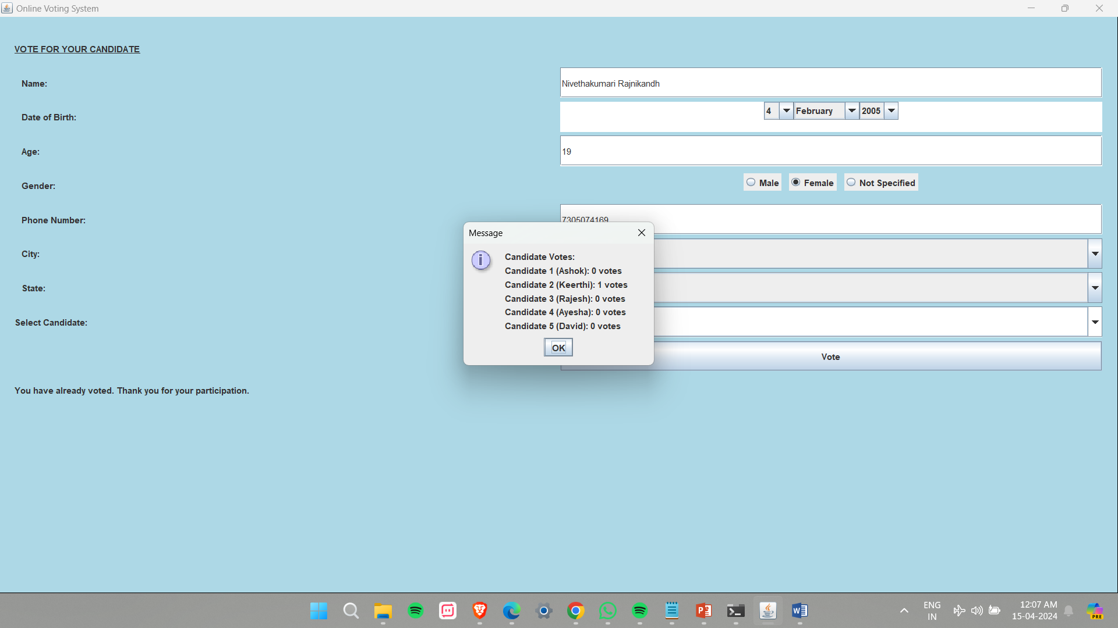
The Name field is the place where the Voter Name is filled.
The Name field consists of a Condition in which no “Numbers” and “Special Characters” can be entered in the field.
Already Entered Voter Name cannot Vote again for another candidate and hence the message will be displayed that the Voter had already Voted.

Slide 6

The Date of Birth field is present where the voter’s Date of Birth can be entered using a combo box feature which consists of a drop-down button with all 12 months and years from 1920 – 2019 and the date box as well.
After the Voter enters the Date of Birth Field the age is Automatically Generated using the Action event method and the age field cannot be manually changed by the Voter.
By using this Age Calculation, it is easy to identify the eligibility of the Voter (Voters who are 18 years or above are eligible to vote, otherwise, they can’t vote.)
A Display Message is present to represent the candidates’ vote numbers.

Slide 7
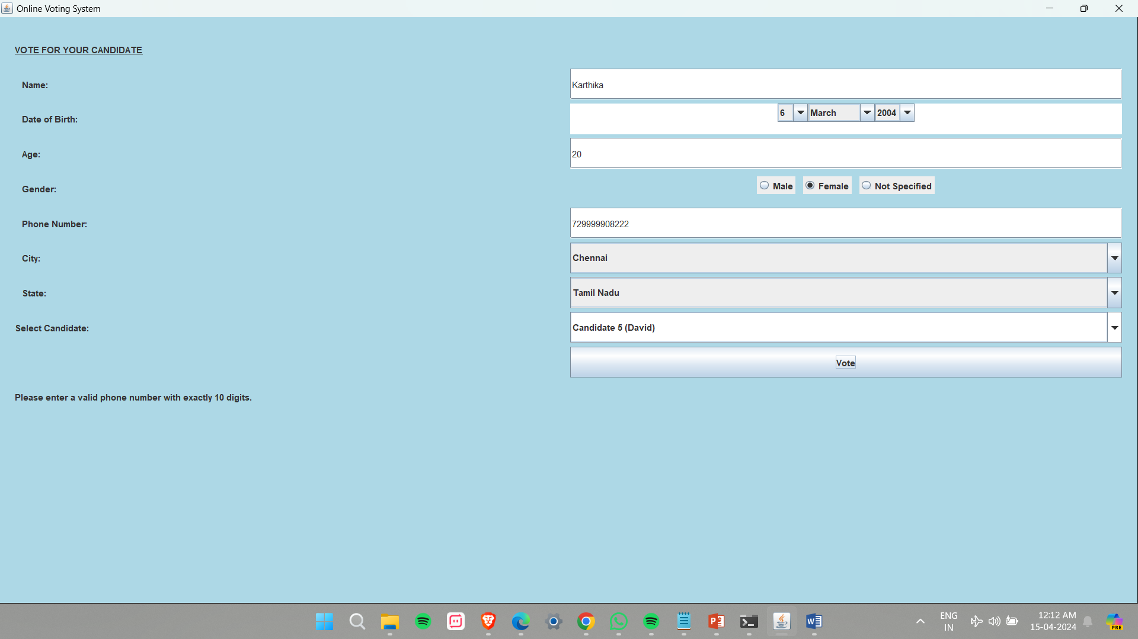
The Next Field in the Voting System is the Gender field, which consists of Three Radio Buttons. This Radio Button works on the condition that only one must be selected.
The Phone number field is Present where the Voter should Enter their Mobile Number.
A Condition is made for the Phone number field where exactly 10 Digits of numbers should be Entered or else the next action will not take place.

Slide 8
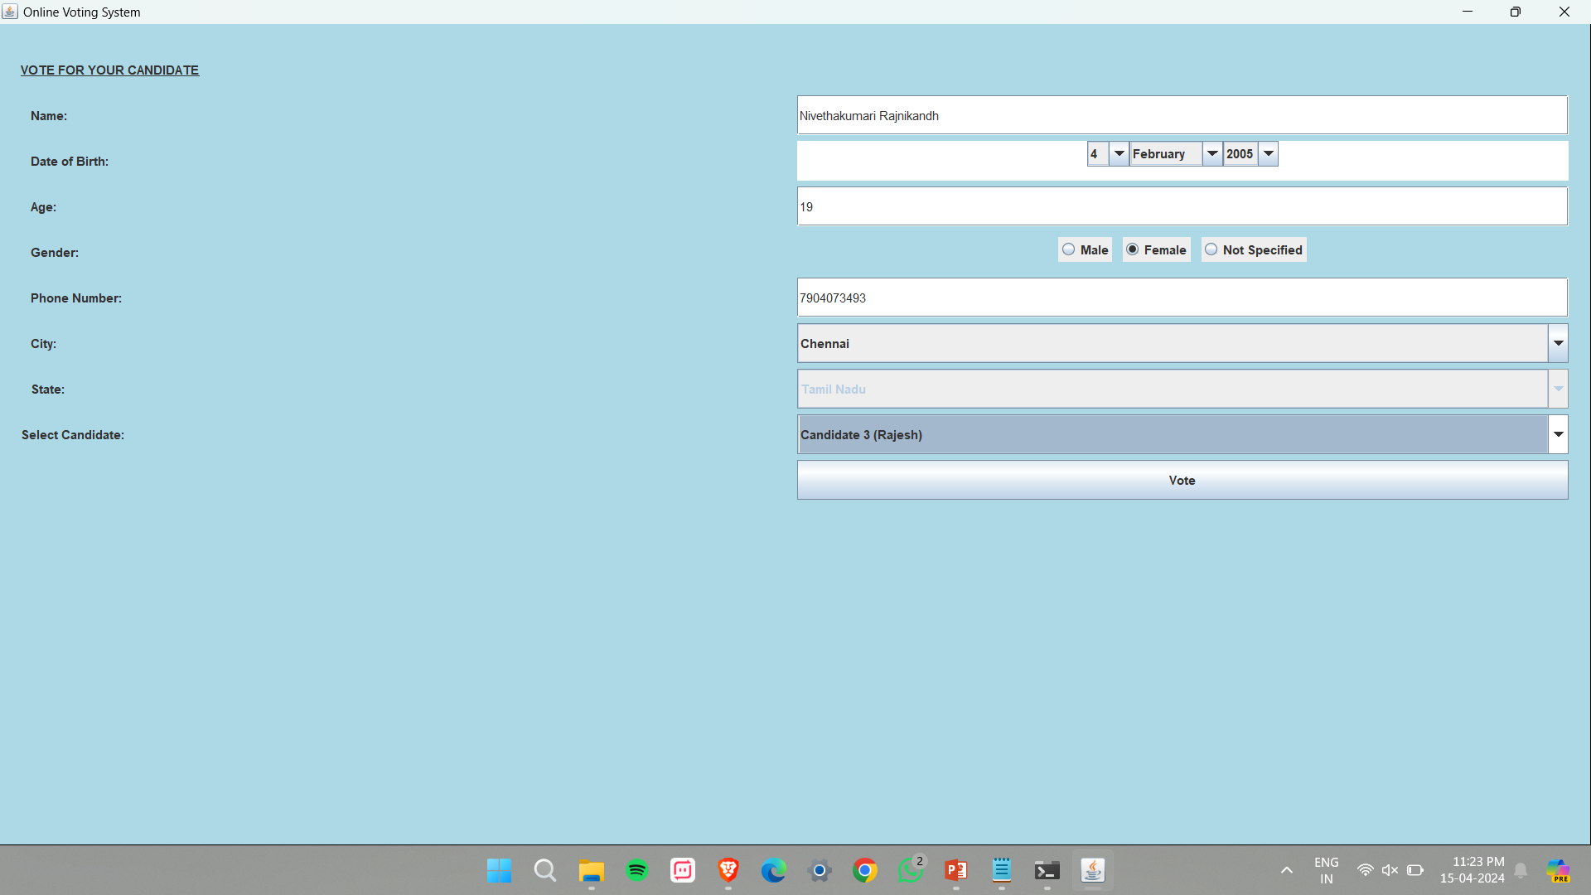
The Online Voting System consists of City and State Field, which is in Combo Box format consisting of Drop-Down Button where the Cities and States will be displayed in alphabetical order.
Here, when the Voter Enters their City, automatically the state will be generated and the state field cannot be changed. This can be achieved by Hashing where the given cities are mapped to their respective state.

Slide 9
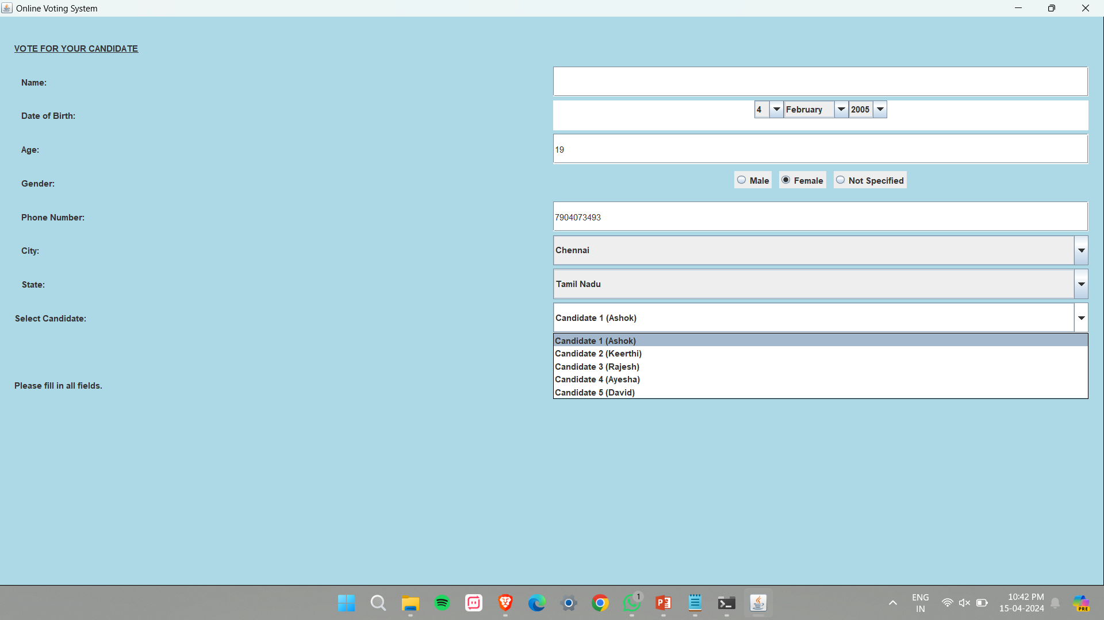
The Final field is the Candidate field, where the list of Candidates is present. The Voter should Vote for any one of the given candidates.
There is a Constraint given to fill in all fields.

Slide 10


Finally by entering the correct details, the Voter is eligible to vote for their Candidate!!

Slide 11
THANK YOU!

